Slide 1
Code Documentation
Rasmus Lystrøm
Associate Professor
rnie@itu.dk

Slide 2
“No one reads documentation” and “I already know how it works”
No one reads their own documentation (very often)
It’s not for you but for the next guy or for the team

Slide 3
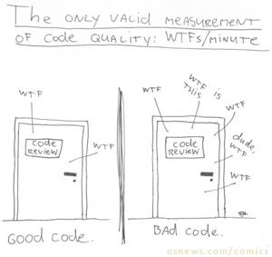
There is no self-documenting code!
But some code is more self-documenting than other code(!)

Slide 4

Code Documentation
My code is so good it does not require comments
Everything should be documented
Nothing should be commented
That’s what you think.
Who’s correct?
Source: Technical Writing: Documentation on Software Projects by Amber Israelsen

Slide 5
Comments
/// <summary>
/// Gets the time zone based on US state and city
/// </summary>
/// <param name="state">US State</param>
/// <param name="city">US City</param>
/// <returns>Time Zone</returns>
public string GetTimeZone(string state, string city)
{
var timeZoneId = TimeZoneLookup.Find(state, city);
var timeZoneInfo = TimeZoneInfo.FindSystemTimeZoneById(timeZoneId);
return timeZoneInfo.ToString();
}

Slide 6
Requirements change
/// <summary>
/// Gets the time zone based on US state and city
/// </summary>
/// <param name="state">US State</param>
/// <param name="city">US City</param>
/// <returns>Time Zone</returns>
public string GetTimeZone(string country, string state, string city)
{
var timeZoneId = TimeZoneLookup.Find(state, city);
var timeZoneInfo = TimeZoneInfo.FindSystemTimeZoneById(timeZoneId);
return timeZoneInfo.ToString();
}

Slide 7
Comments
/// <summary>
/// Constructor
/// </summary>
public Ellipse()
{
}
Stating the obvious

Slide 8
Comments
/// <summary>
/// Move ellipse to new point
/// </summary>
/// <param name="newPoint">The point</param>
public void MoveEllipse(Point newPoint)
{
...
}
Stating the obvious

Slide 9
Comments
Stating the obvious
// Instantiate a new instance of Ellipse
Ellipse ellipse = new Ellipse();

Slide 10
Comments
Explain poorly written or poorly designed code
// Check to see if the SMS failed by checking for 4
if (message.Status == 4)
{
// Do something
}

Slide 11
Comments
private void GiganticMethod()
{
//Do the first thing
//...
//Do the second thing
//...
//Do the third thing
//...
//Keep going forever
}
Explain poorly written or poorly designed code

Slide 12
Comments
//// Check to see if the SMS failed by checking for 4
//if (message.Status == 4)
//{
// // Do something
//}
Sort of delete code

Slide 13
Comments
/// <summary>
/// Encapsulates logic for sending notifications and
/// taking action based on the user's response
/// </summary>
public class NotificationService
{
}
High-level comment

Slide 14
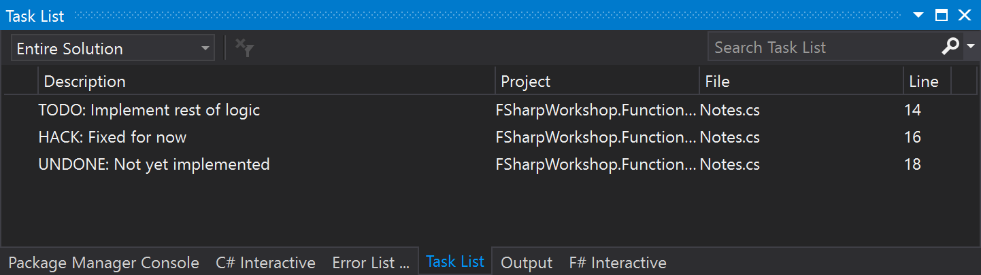
Comments
//TODO: Implement rest of logic
//HACK: Fixed for now
//UNDONE: Not yet implemented

Slide 15
Deliverables: Code Documentation
Don’t use comments to:
state the obvious
explain poorly-written or poorly-designed code
sort of delete code
Do use comments for:
high-level comments
Visual Studio Task List:
//TODO
//HACK
//UNDONE
Source: Technical Writing: Documentation on Software Projects by Amber Israelsen

